Slide 1

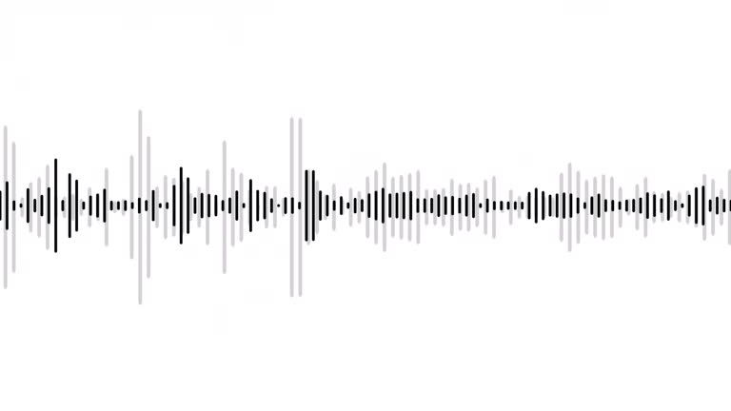
Data 605: Actionable Visualization and Analytics
Data Story Review
Mapping New York’s Noisiest Neighborhoods
Reviewed by Success Attoni

Slide 2

I
Intro / Background
The Dataset, Analysis approach & Possible Tools
Overall Message
Key Takeaways
Analysis Strengths
Areas of Improvement
Conclusion
01
02
03
04
Outline
05
06
07
2

Slide 3



I
Keep it simple and impactful
01
Intro/Background
02
03
04
MAPPING NEW YORK’S NOISIEST NEIGHBORHOODS
Ben Wellington
05
Blog Post Published on the NEW YORKER
Published: 17 January 2015
06
Data Scientist (calls himself a “Data Storyteller”)
PhD in Computer Science (Natural Language Processing) – NYU
B.S in Math and Computer Science – Bucknell University
Visiting Assistant Professor, teaching statistics at the City & Regional Planning Program, Pratt Institute, Broklyn, USA.
Deputy Head of Feature Forecasting at Two Sigma.
Teaches Public speaking and job training skills at Cherub Improve
Founder, I Quant NY
Ted talk: Making data mean more through storytelling.
Inspiration to work on NY City Data:
Signing of NYC Open Data into law by Mayor Blomberg - 2011
Make a positive impact, cause change, improve NYC.
Married to an urban planner.
07
About.
An analysis of over 140,000 noise complaints (calls) logged by New York City’s 311* between the winter of 2013 and the fall of 2014 to uncover insights on:
The major noise sources
Complaint profile across weekdays and time
The noisiest and quietest neighborhoods in the NYC.
And…
Producing fit-for-purpose visuals to best convey the analysis including maps of the city showing analysis
Intro / Background
* 311 is NYC’s call number for non-emergency city service and information
3

Slide 4

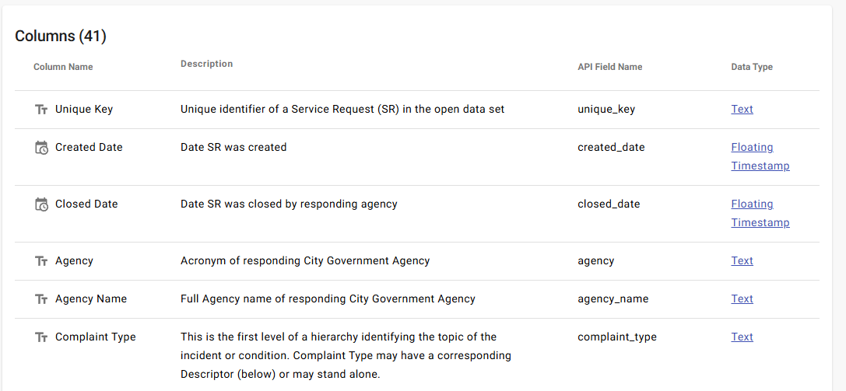

I
01
The Dataset
https://nycopendata.socrata.com/Social-Services/311-Service-Requests-from-2010-to-Present/erm2-nwe9/about_data
02
03
04
05
NYC 311 Service Requests From 2010 to Present
06
Update Frequency: Daily
Date made public: October 18, 2011
Date Created: October 9, 2011
Data Format: CSV download available, etc
07
What’s in the Dataset?
Rows
Columns
Each row is a
38.9M
41
311 Service Request.
Possible Data Processing Workflow and tools used:
Define
Purpose
Acquire
Prepare
Explore
Analyze
Visualize
Data
What’s the end game. Why do this?
Develop guiding questions
Interests, educate, Force change and impact my city
Source for the relevant data to address the end game.
NYC OpenData Portal
Acquire the Data.
Download data (possibly CSV file) from
NYC OpenData Portal
Clean and wrangle the data
e.g. convert datatypes, handle missing values, engineer futures, Filter to subset, etc.
Python or R
Interrogate dataset.
Summary stats,
Feature Profiles feature distribution. Feature ranges, etc.
Python or R
Transform, manipulate to answer guiding questions and unlock insights.
Python
Excel
Present insights in suitable visuals to enhance understanding & engagement
Excel,
QGIS,
Folium
The Dataset
4

Slide 5
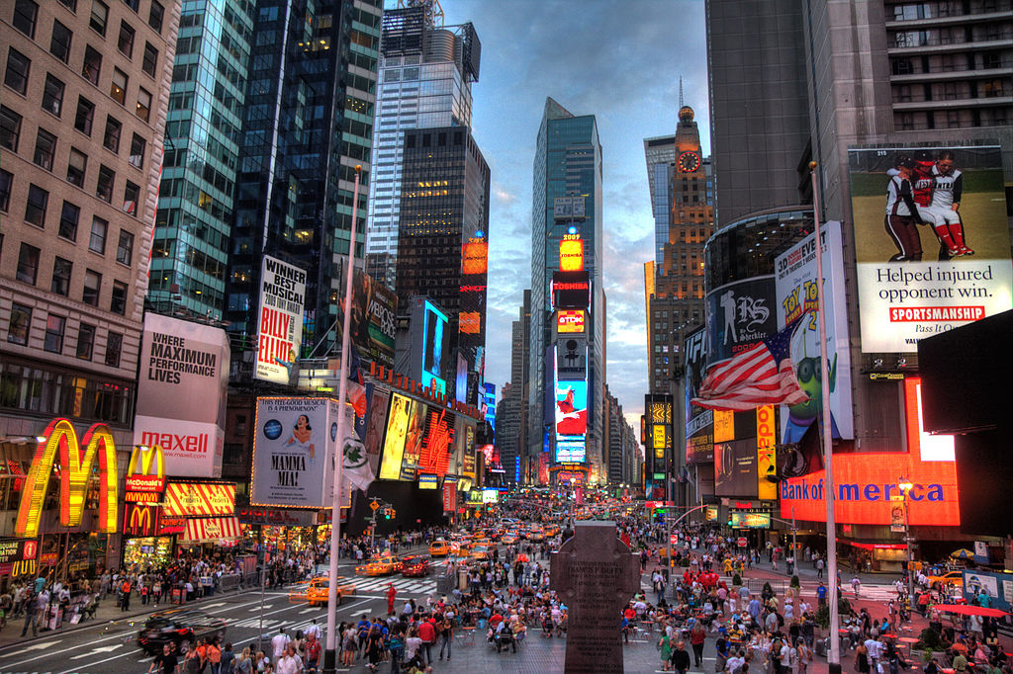
Overall Message
I
01
02
03
Noice pollution is a critical issue in NYC
Noise sources within the city is diverse, influenced by urban planning, social behaviour and even cultural differences. It also varies with respect to time of the day and weekdays.
A data-informed approach is crucial for policy makers to design tailored noise control strategies.
04
05
06
07
Over
Overall Message
140K
Noise Complaints logged between winter of 2013 and the fall of 2014
5

Slide 6
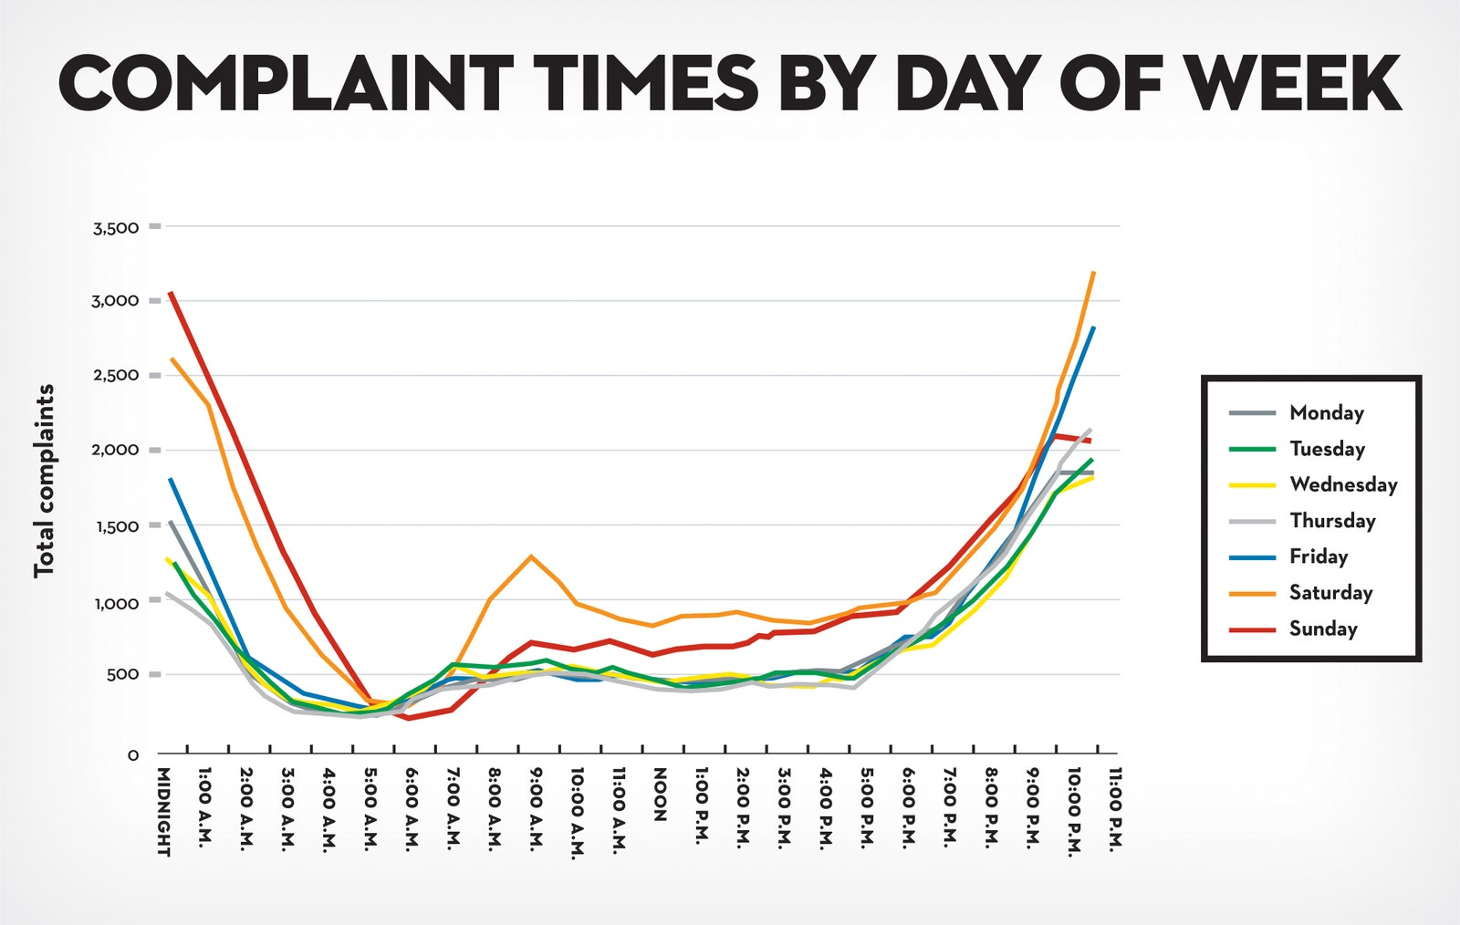
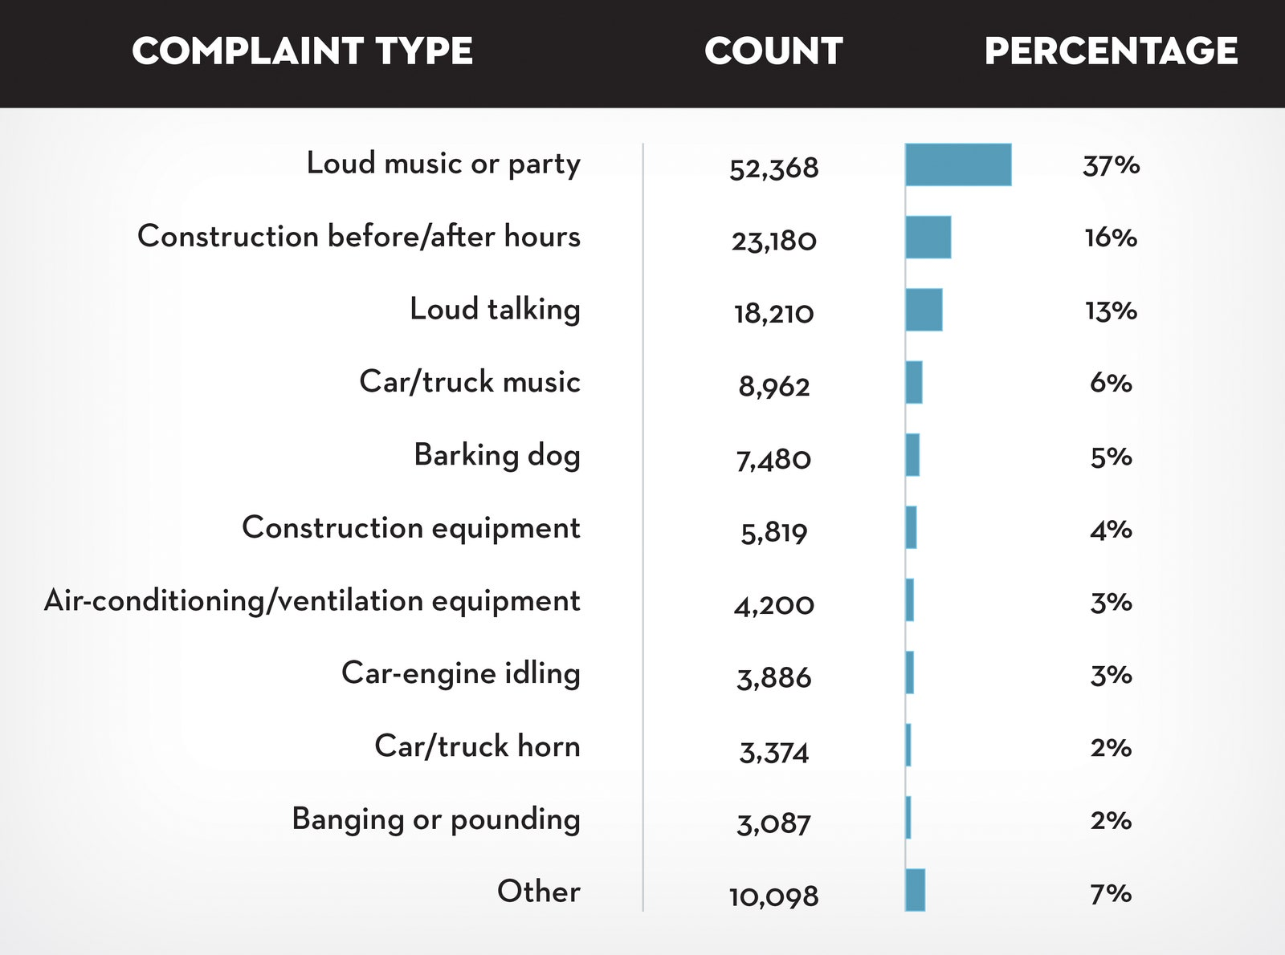
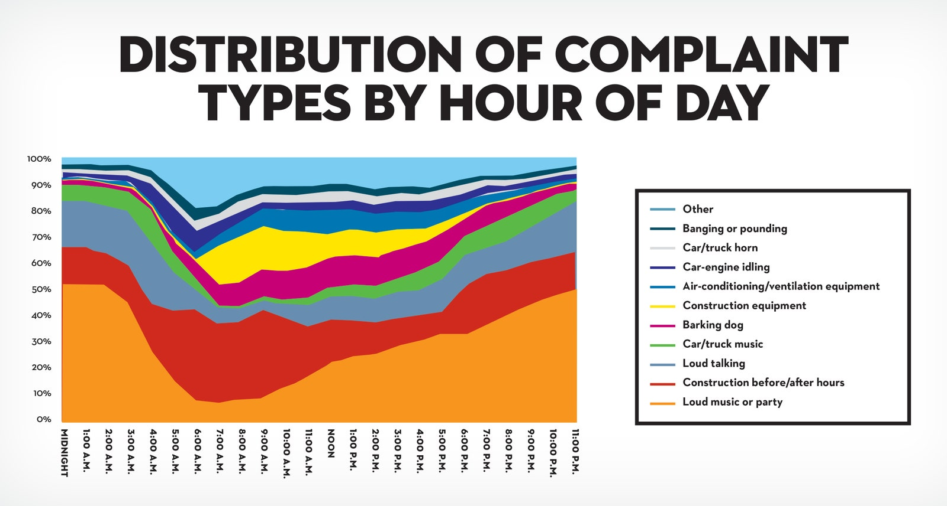
Key Take Aways
I
B
01
Loud music or Party
1. Noise is a Major persistent issue
Average of one complaints every four minutes
2. Social behaviour drives many noise complaints (fig A)
Most common noise complaints: loud music and parties followed by after hours construction and loud talking.
3. Nose complaints follow distinct patterns (fig B and C)
Complaints peak at 11 pm and midnight. Especially on weekends when parties and loud social gatherings are prevalent.
02
03
04
05
06
07
A
Distribution of Complaint Type
C
Ley Tak Aways
6

Slide 7
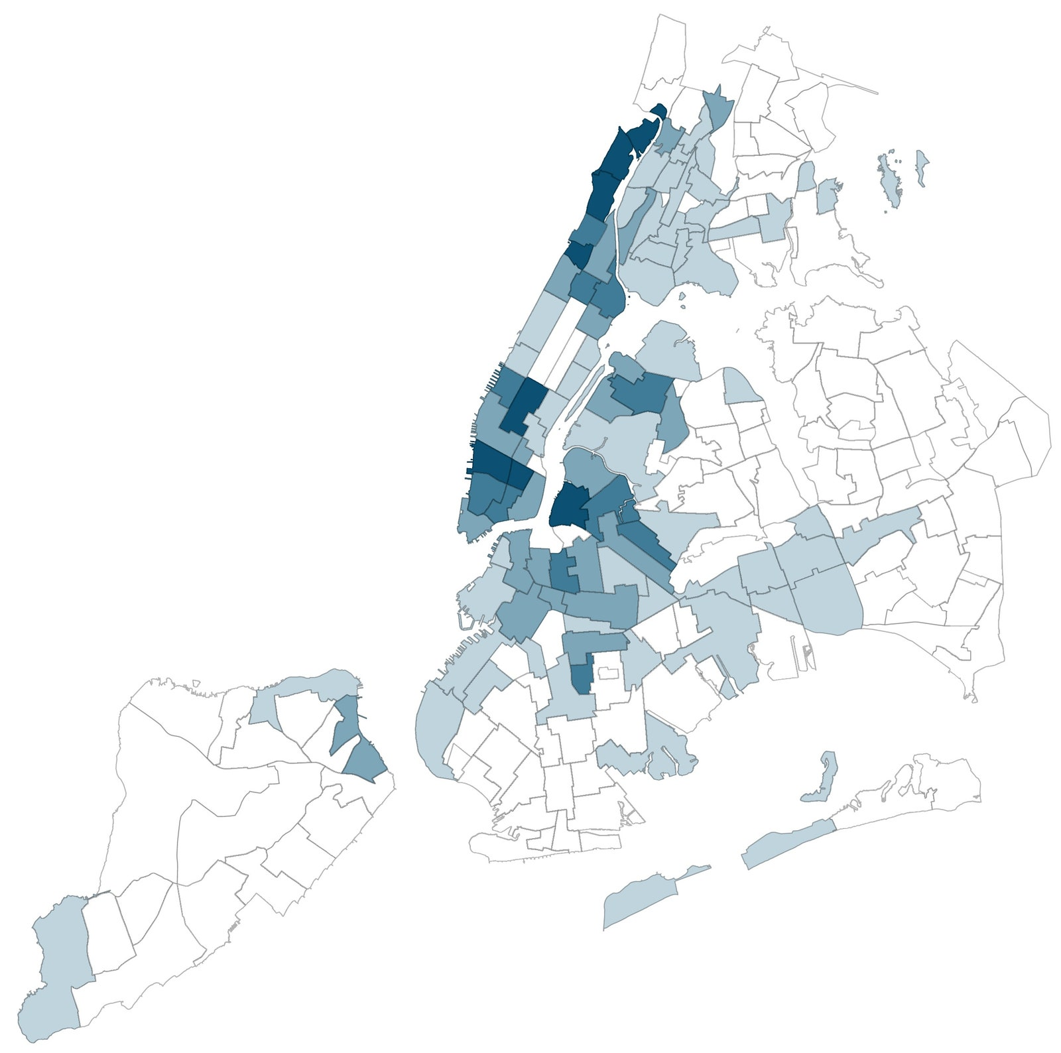
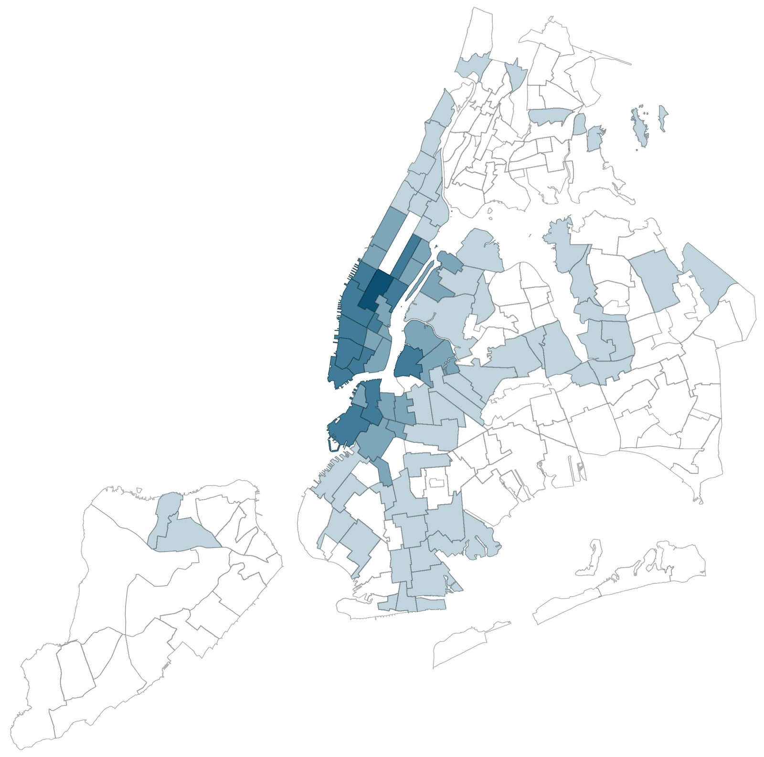
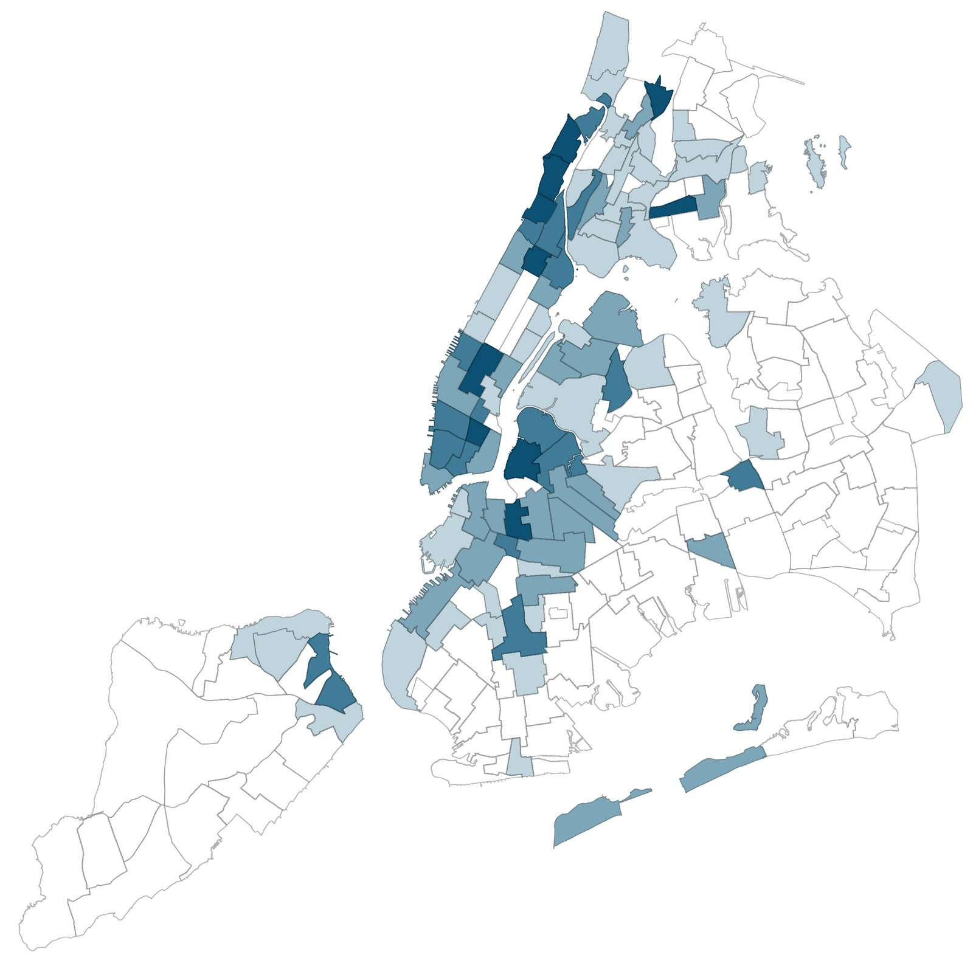
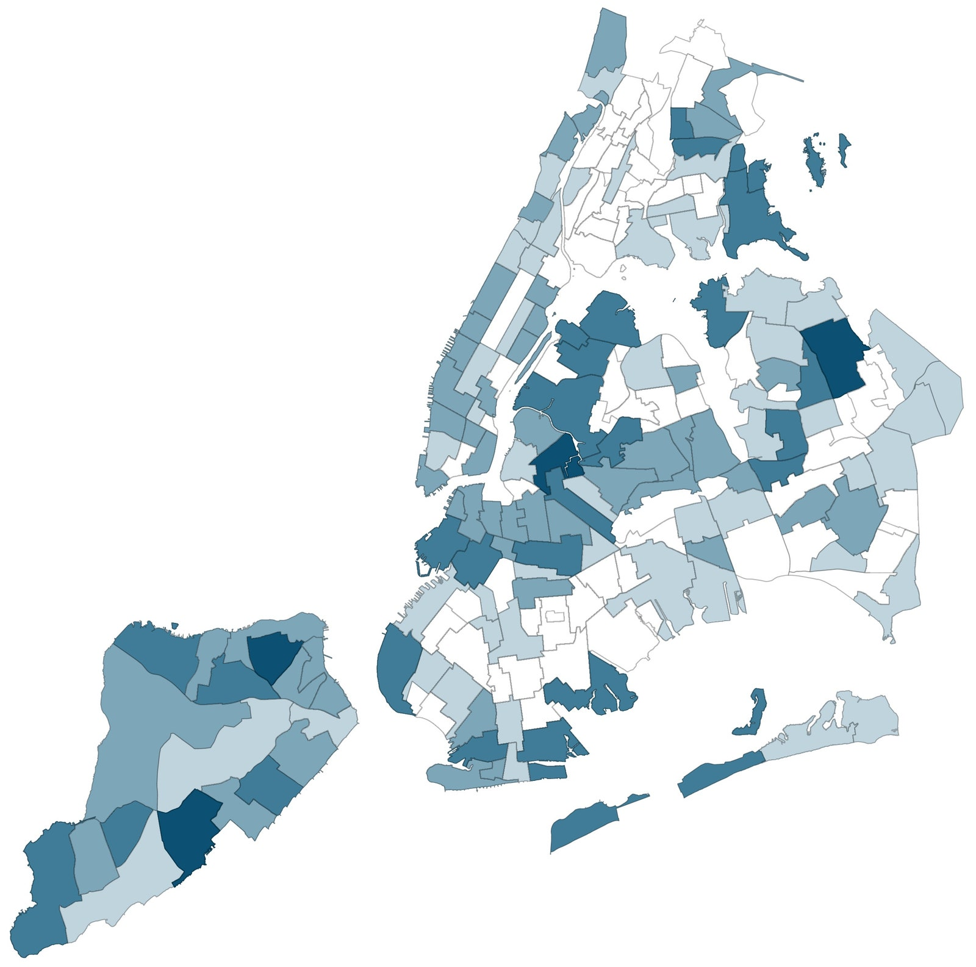
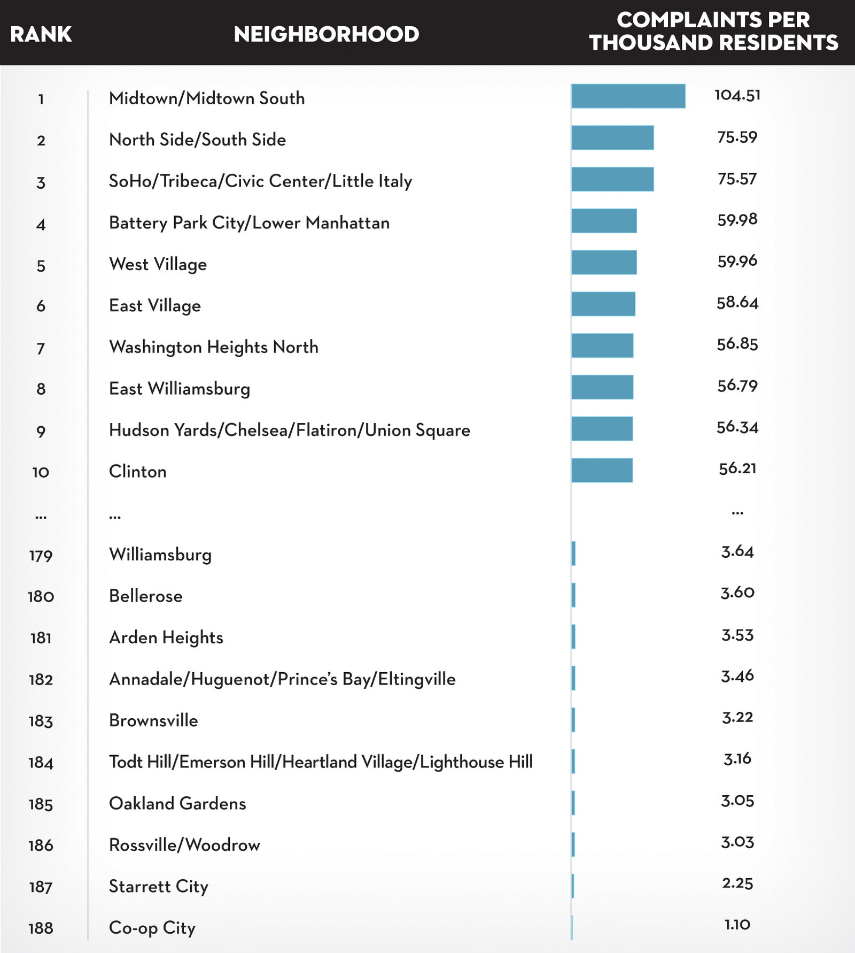
Key Take Aways
I
Mapping of Complaint type
01
B
Loud parties
B
Construction equip.
4. Noise distribution varies by neighborhood. (fig A)
Midtown Manhattan has the highest complaint
Quieter Neighbourhoods, such as Co-op City (Bronx) planned as a residential development has low level of complaints.
02
Midtown Manhattan
03
Inwood Manhattan
04
05
5. Different Neighborhoods have different noise issues (See maps)
Loud parties: most common in Inwood/Marble Hill.
Loud talking: mostly reported in Norwood (Bronx)
Construction noise: concentrated in Midtown, Lower Manhattan, and North Brooklyn
Etc…
06
07
B
Loud talking
B
Barking dogs
A
Distribution of Complaint Type
Norwood (Bronx)
Key Take Aways
7

Slide 8

Strength of Analysis & Blog Post
I
01
02
1. Used real-world data
Blog was about a real issue, not a fictitious one, and is relatable.
2. Distilled noise complaints by type, time and geography
Identified top 10 sources of noise complaints, accounting for 95% of all reports.
Effectively analyzed trends over time, mapped out noise complaints by neighbourhood area.
3. Effective use of Visualizations.
Used time-series charts to visualize complaints over time
Bar charts used to show category-based visuals.
Geospatial mapping of noise distribution across the city.
4. Provided thoughtful insights and acknowledged data limitations.
Excellent analysis and insights highlighted, including the interesting observation of spikes in Saturday morning complaint, leading to speculations about human behaviour, sleep habit, and cultural factors
5. Offered recommendation for data driven noise management solutions
…to the NYPD and Department of Environmental Protection.
6. Accessible and Engaging Storytelling
Blends data with storytelling – blog is engaging and draws from personal observations, humour. No technical jargon – easy to understand for non-technical readers.
03
04
05
06
07
07
08
Strength of Analysis & Blog Post
Engaging, light, simple read with clear messaging.
8

Slide 9

Areas of Improvement
I
01
02
1. Potential biases in the data ( 311 complaints <> Actual Noise Levels)
Assumes 311 complaints reflect actual noise levels. | Correlate complaint data with actual noise measurements (e.g. decibel readings from environmental sensors)
Lacks depth on effect of cultural differences in tolerance to noise | Discussion on complaint underreporting in certain demographics could add depth.
2. Limited discussion on data accuracy and missing information.
No discussion about data quality related issues (missing information, duplicates, misclassification, etc.) | Incorporation of a paragraph on data issues and resolution, data cleaning process would improve transparency.
3. Insufficient consideration of external factors affecting noise.
No consideration was made to city events (e.g. parades, concerts, sports games, etc), weather consideration, etc that could result spikes in complaints.| Overlaying event schedule, weather data, etc may offer more insights.
4. Did not propose concrete solutions to address noise pollution.
No discussion on noise reduction strategies (e.g. zoning changes, insulation requirements, etc. ) | Proffer practical solutions based on the data.
5. Visualizations could be interactive.
Visuals (map and plots) are static, limiting the user from exploring the analysis. | Make maps and visuals interactive (possibly use plotly).
Visuals are not numbered, and maps do not have legend. | Number all visuals.
03
04
05
06
07
Areas of Improvement
“Complaint” is not equal to noise level.
Effect of external conditions resulting in more complaints not extensively highlighted.
Interactive visualizations (especially the maps) will offer the user the ability to explore the data more.
9

Slide 10
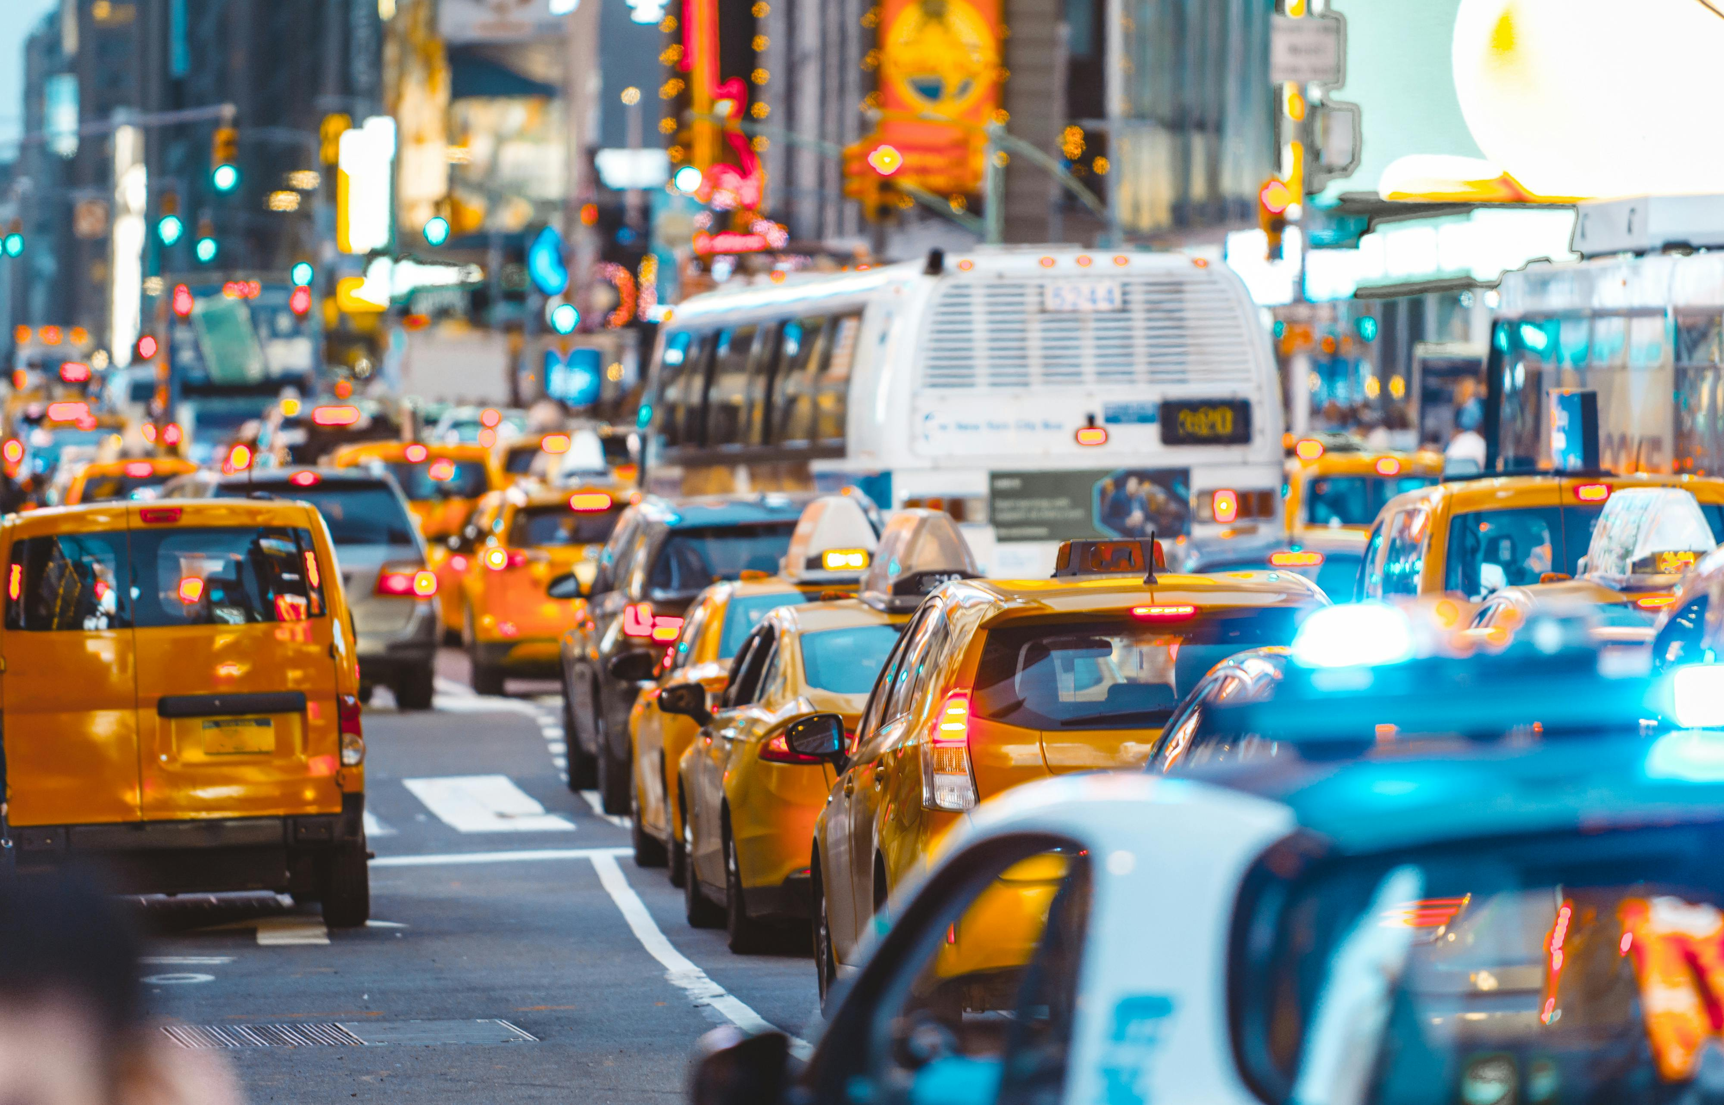
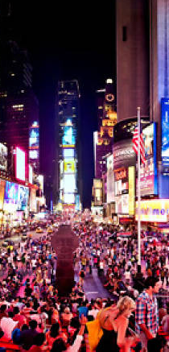

I
Conclusion
01
02
Well written blog post on New York City’s Noise Landscape.
140,000+ 311 noise complaints analyzed to reveal the city’s noisiest and quietest neighbourhoods.
Nighttime peaks for social noise, morning spikes for construction
Noisiest neighbourhood is Midtown, planned residential areas are the most quiet.
Strengths
Effective use of data.
Strong visual storytelling through text, maps and charts.
Insightful discussion on neighborhood and noise source.
Improvement Areas
Note that noise complaints is not same as actual noise levels
Adding external factors that may cause spikes in complaint profile (e.g. city wide parades, sporting events, etc) will make the analysis more robust
Make visuals interactive and add legends where necessary.
Propose strategies to tackle the menace of noise pollution.
03
04
05
06
07
"A compelling data-driven analysis of NYC’s noise complaints, revealing patterns in urban sound and social behavior.
Strong visuals and insights, could benefit from making visuals interactive, considering external factors in the analysis, and proposing policy solutions.“
Conclusion
10

Slide 11
Thank You

Slide 12
References:
https://www.newyorker.com/tech/annals-of-technology/mapping-new-york-noise-complaints
https://www.linkedin.com/in/benjaminwellington/
https://www.cherubimprov.org/
https://iquantny.tumblr.com/about
https://www.youtube.com/watch?v=6xsvGYIxJok

